Slide 1
AIRGAIN
BRIAN CRITCHFIELD | TRACY LIU

Slide 2
AIRGAIN SPEAKERS
BRIAN CRITCHFIELD
TRACY LIU
30 years of marketing experience
25 years of digital marketing experience
Teaches graduate marketing and strategy
International speaker, consultant, and author
Currently, VP of Global Marketing at Airgain
Over 3 years at Airgain previously managing manufacturing reps, embedded sales, and aftermarket channel for the Western region
16 years of experience in channel management
20+ years in technical solution sales
Currently responsible for channel, distributor relationships, and strategic alliances

Slide 3
AIRGAIN - NEW BRAND ARCHITECTURE

Slide 4
AIRGAIN - History

Slide 5
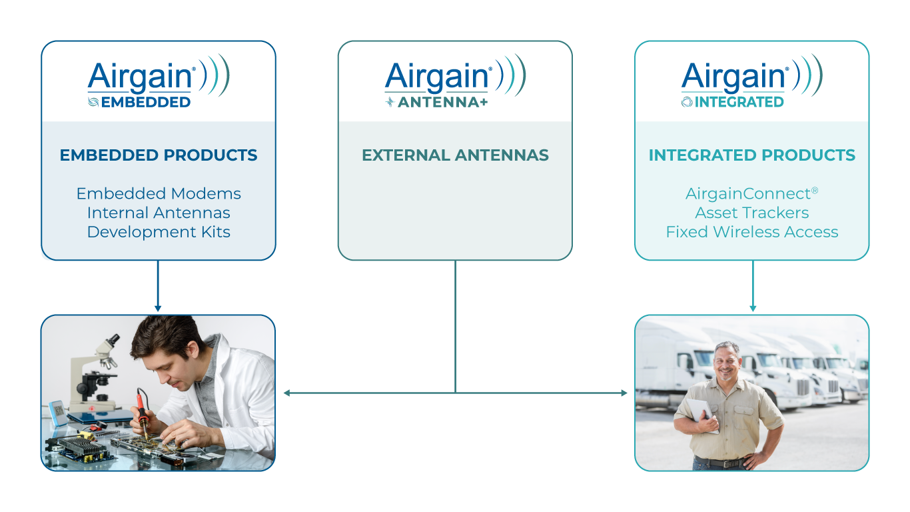
BRAND ARCHITECTURE - Audiences
Design Engineers
End Users
Software and hardware engineers
Solving for connectivity issues in their next product release
Every wireless project needs a modem and an antenna
Need speed to market and simplicity
Airgain is seeking design wins
Decision makers within vertical markets
Solving for connectivity issues in their operating environment
Need ROI from improved efficiency or productivity
Airgain is seeking an installation

Slide 6
BRAND ARCHITECTURE - Products
IoT
Fleet

Slide 7
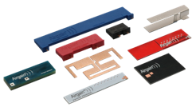
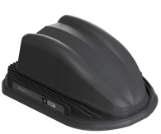
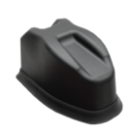
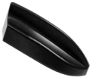
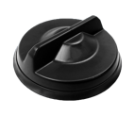
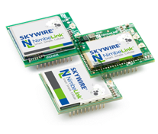
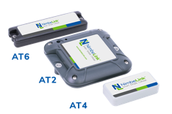
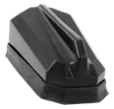
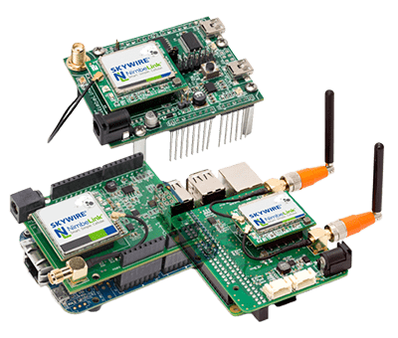
BRAND ARCHITECTURE – Sub-brands
EMBEDDED ANTENNAS
VEHICLE NETWORKING
FLEET ANTENNAS
NIMBELINK MODEMS
ASSET TRACKING
SOFTWARE
NLink
IOT ANTENNAS
PRIVATE LABEL
DEVELOPMENT KITS

Slide 8
Value Proposition
We Simplify Wireless
Whether its complex antenna design, end-device certified modems, software agnostic asset trackers, or signal-enhanced vehicle networking, Airgain helps you get connected quickly.

Slide 9
AIRGAIN - NEW WEBSITE

Slide 10
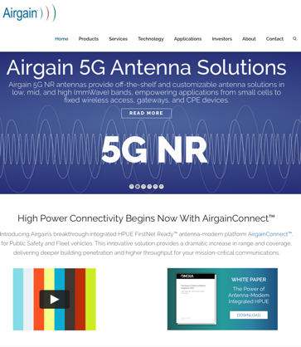
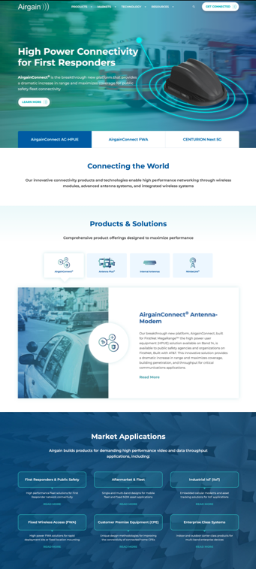
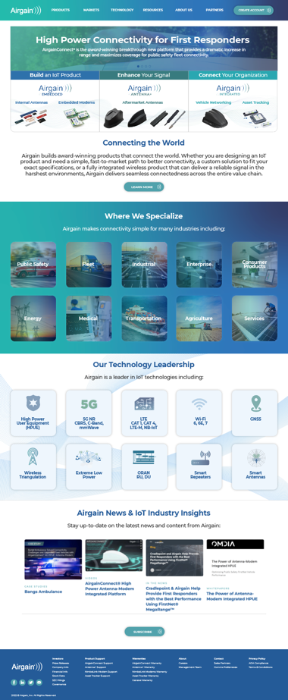
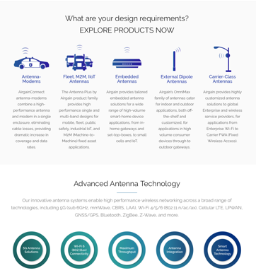
2022 Airgain Website

Slide 11
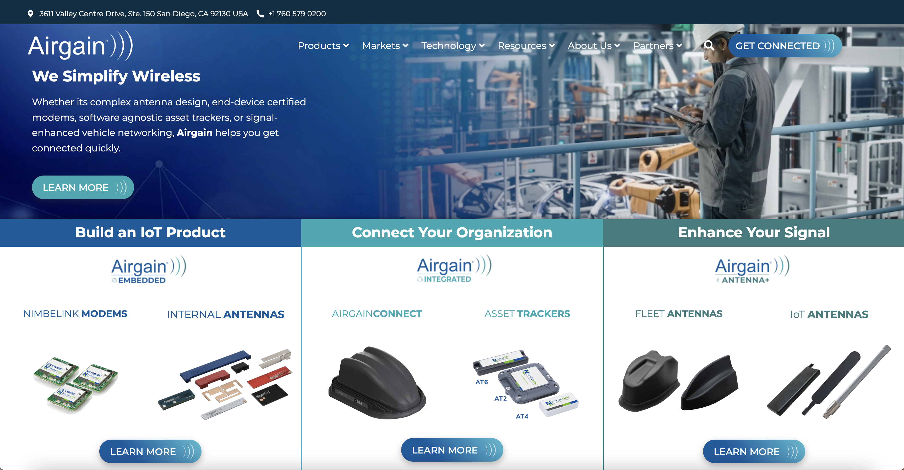
2022 Airgain Website
When users land on our homepage they will be able to follow one of three paths to reach the information best suited for them:
Embedded - Build an IoT Product
Integrated – Connect Your Organization
Antenna+ - Enhance Your Signal

Slide 12
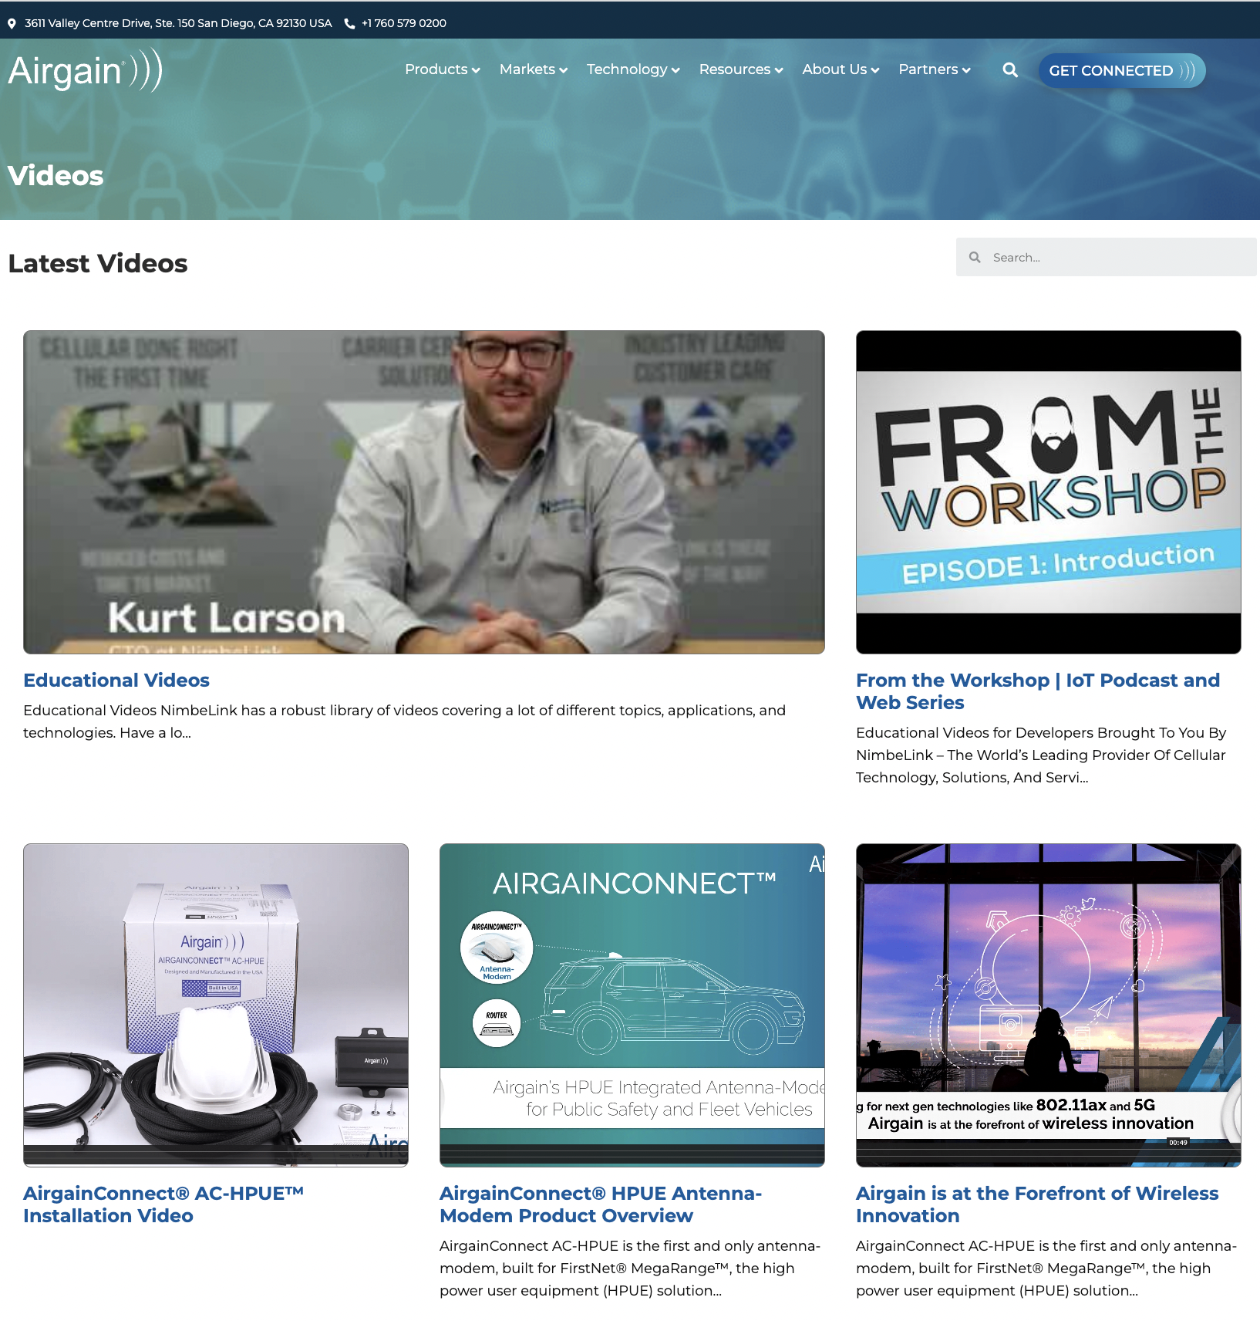
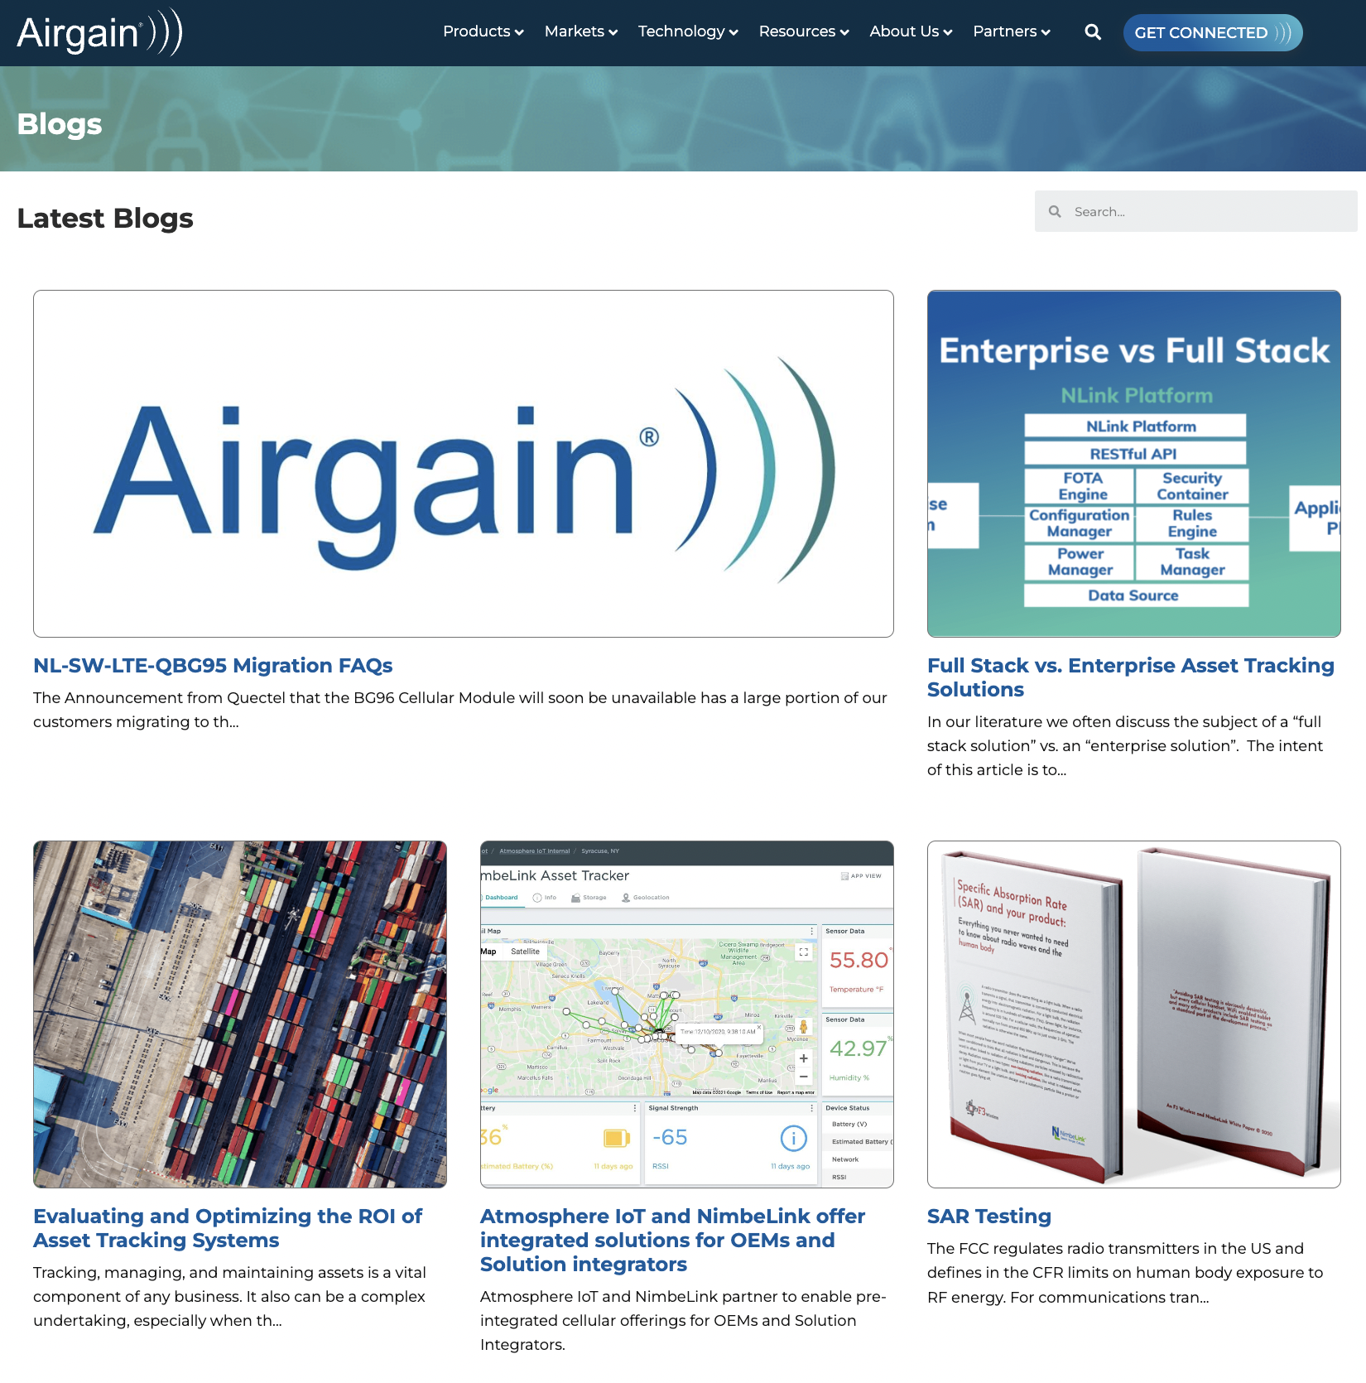
Continued Focus on Education

Slide 13
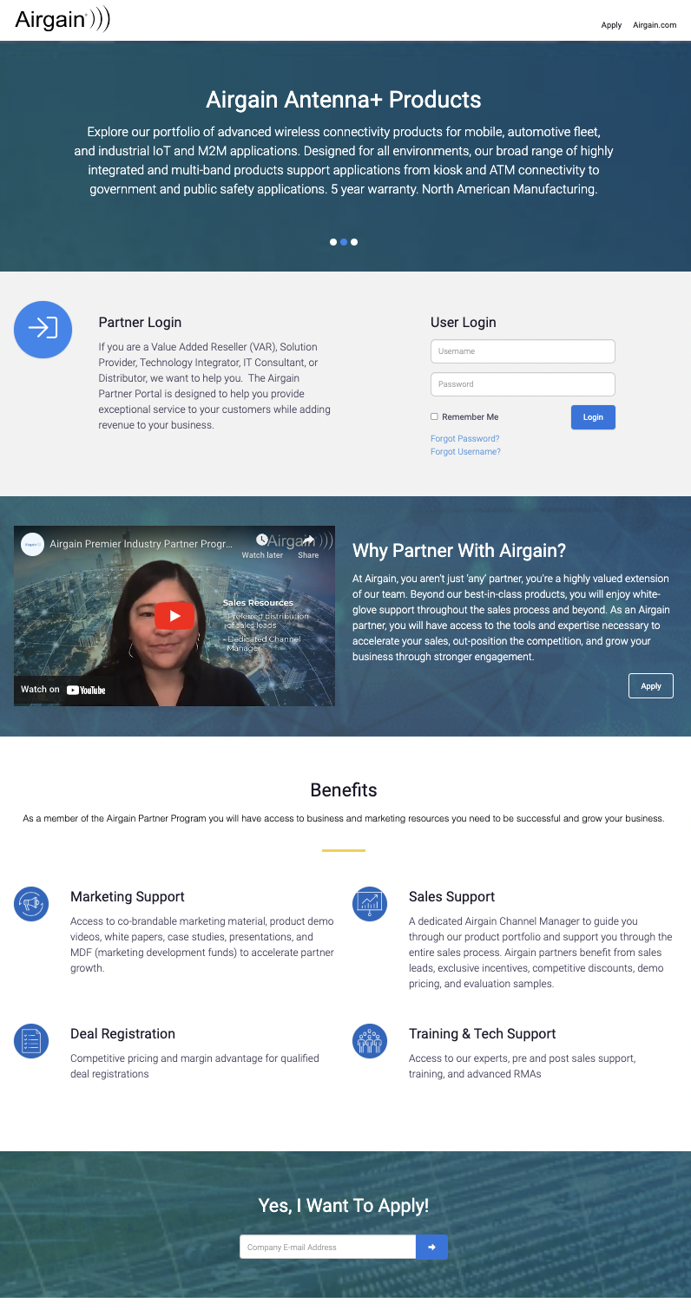
Continued Focus on Partners

Slide 14
AIRGAIN – PARTNER PROGRAM

Slide 15
Why Partner with Airgain?
Sell broad Antenna+ portfolio of products for mobile, fleet, IoT, and M2M
Access to unique, differentiated products like AirgainConnect
Robust and rugged antennas that “just work” with a 5 year warranty to prove it
Culture of support
Generous compensation with price protection

Slide 16
Airgain Reseller Program
Sales Support
Preferred distribution of Sales leads from Airgain Marketing campaigns
Assistance at tradeshows which can include loan of equipment and on-site Sales professionals
Direct access to a dedicated Channel Manager and Channel Specialists
Assistance with RFIs, RFQs, and RFPs from Airgain
Access to Airgain Sales Specialists for assistance with unique configurations
Marketing Support
Access to Partner Portal and MDF for Airgain Authorized Resellers
Access to Airgain Marketing co-brandable collateral
Co-sponsorship of approved events (each event is evaluated individually by Airgain)
Access to marketing resources
Pricing Advantages
Competitive pricing and margin advantage for qualified deal registrations
Generous discounts and the ability to earn excellent margins
Demo equipment purchased at a greater than normal discount
Expert Support
Priority access to Pre- and Post-sales support for Airgain Authorized Resellers
Access to Airgain knowledge base and FAEs
Dedicated channel manager to guide you through our product portfolio provide support through the entire sales process

Slide 17
Airgain Reseller Tiers
Program Requirements | Affiliate | Select | Premier
Minimum Annual Revenue Commitment | $0 | $25k | $100k
Partner Application Profile | • | • | •
Program Benefits
Access to Partner Portal | • | • | •
Airgain Logo usage | • | • | •
Approved to sell Antenna+ products | • | • | •
Approved to sell AirgainConnect | • | • | •
Ongoing communications and Airgain news | • | • | •
Co-brandable Asset Library | • | • | •
Dedicated Airgain Channel Manager |  | • | •
Priority access to pre- and post-sales support |  | • | •
Deal Registration |  | • | •
Marketing Resources |  | • | •
Proposal based Marketing Development Funds (MDF) |  | • | •
30-day evals/samples |  | • | •
Demo Pricing |  | • | •
Special Pricing |  | • | •
Promotions |  | • | •
Partner Advisory Council candidate |  |  | •
Highest margin level with Airgain |  |  | •
Notes:
Airgain offers a tiered program for Channel Partners who sell both Antenna+ and Airgain Integrated products. At Airgain, we recognize that our channel partners are the key to our success. No matter how great a tool or technology is, our customers benefit when they have support from trusted advisors, from implementation to expert training.

Slide 18
AIRGAIN – DEAL REGISTRATION PROGRAM

Slide 19
Airgain Deal Registration Benefits
Our Airgain Partner Program members receive access to a bevy of marketing and business resources to help
you grow your business and enjoy sustained success.
Profitability enhancement. Deal registration may add additional gross profit margin to an already profitable sale.
Opportunity protection. If a partner’s prospect contacts Airgain, we will be aware that a specific partner is involved in the opportunity and avoid inadvertently engaging another partner in the account.
Opportunity control. If a registered prospect contacts Airgain, we can refer the prospect back to the partner and brief the partner on any communication that has taken place directly with Airgain.
Special pricing and promotion eligibility. Special pricing requests and promotions will only be considered for opportunities that have deal registration approval.
Opportunity Referral. Partner registration activity will be considered when reviewing partner eligibility for leads and opportunities.
Notes:
§▪ Profitability enhancement. Deal registration adds additional gross profit
margin to an already profitable sale.
§▪ Account protection. If a partner’s prospect contacts Digium, we will be
aware that a specific partner is involved in the opportunity and avoid
inadvertently engaging another partner in the account.
§▪ Account control. If a registered prospect contacts Digium, we can refer
the prospect back to the partner, and brief the partner on any
communication that has taken place directly with Digium.
§▪ Sales support. Our sales teams will engage with you on registered deals.
Our metrics show when we are involved in a deal, closure rate increases.
§▪ Special pricing and promotion eligibility. Price deviation requests and
promotions will be honored only for those opportunities that have been
registered.
§▪ Opportunity Referral. Partner registration activity will be

Slide 20
Deal Registration
Antenna+ Fleet antennas (5% additional margin)
AirgainConnect (5% additional margin)
M2M/IoT antennas (no additional margin)
Eligible Products
Deal and Partner Qualifications
Must be registered by an Airgain Select or Premier partner
Customer must be headquartered in the US or Canada
Minimum Deal Threshold
Timeframes
$5,000 MSRP for Antenna+ Fleet antennas
10 units for AirgainConnect High Power antenna-modem
Registration is valid for 120 days
Deals must be registered at least 5 days before closure
If deal registration expires, renewal for additional 120 days will be evaluated by your Airgain Channel manager

Slide 21
Airgain Reseller Program Tiers & Margins
Partner Level | Fleet Antennas w/ Deal reg | Fleet Antennas w/o Deal Reg | AirgainConnect w/ Deal reg | AirgainConnect w/o Deal reg | M2M/IoT Antennas
Premier | 42% | 37% | 32% | 27% | 40%
Select | 37% | 32% | 27% | 22% | 35%
Affiliate | n/a | 30% | n/a | 20% | 30%

Slide 22
AIRGAIN - NEW PARTNER PORTAL

Slide 23
Airgain Partner Portal
Your hub for everything you need to grow your business with Airgain
Co-brandable asset library
Deal Registration and opportunity management
MDF requests
30 day evals/samples
Airgain lead referrals
Pricelists
Promotions
Product notifications – EOL…etc.

Slide 24
AIRGAIN - Q4 PROMOTION

Slide 25
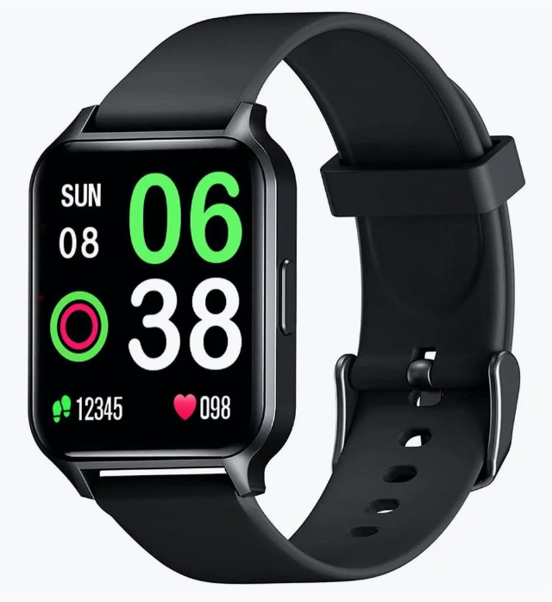
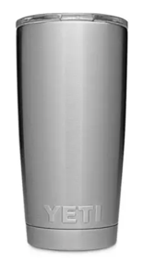
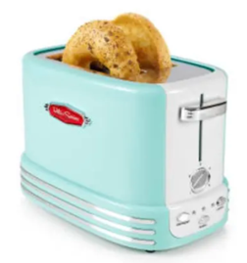
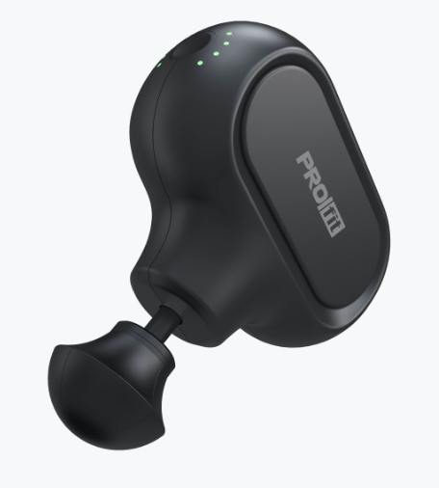
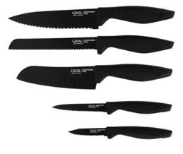
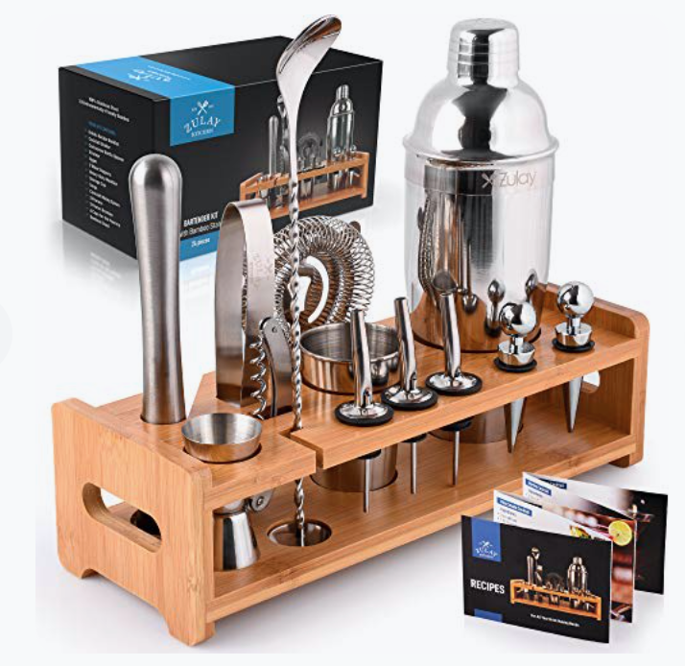
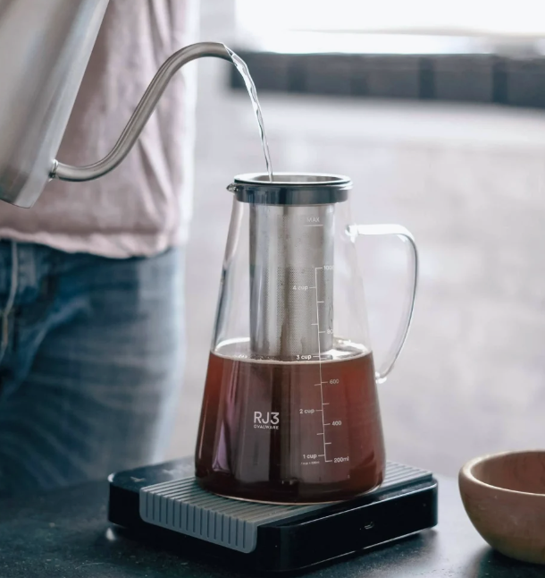
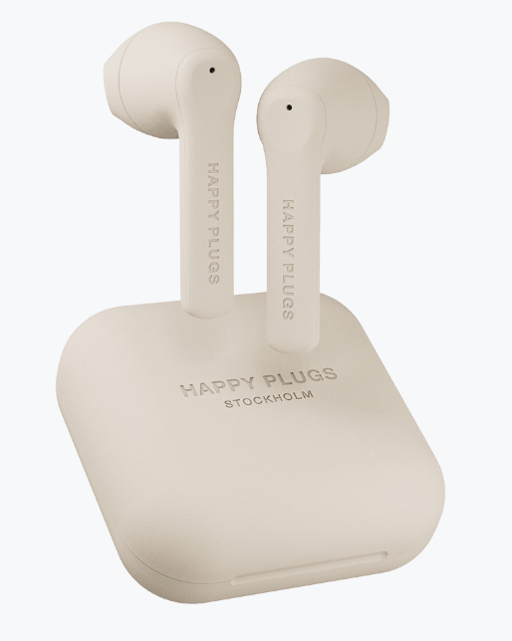
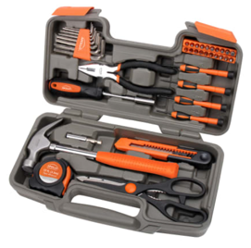
 | Deal Registration Reward* Resellers will receive an incentive of their choosing for each Deal Registration submitted and approved by 12/31/22 * Multiple rewards can be combined into a larger reward

