Slide 1
Channel Marketing Trends & Priorities for 2022 - 2023
Terra Bastolich – CMO, GetWireless

Slide 2
TRENDS | STRATEGIES | TOOLS

Slide 3


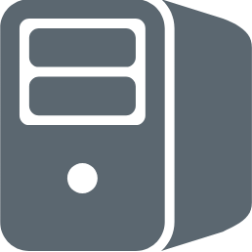








#SHIFT Happens
1970s
1990s
2000s
Today
Products
Product +
Services
Customer
Centric
Relationship
Centric

Slide 4


What we know about the channel
64%
33%
of tech industry spending flowed through the channel or indirect sales.
“By the end of the decade, only 33% of money will flow that way.”
Jay McBain, a channel analyst at Forrester Research

Slide 5
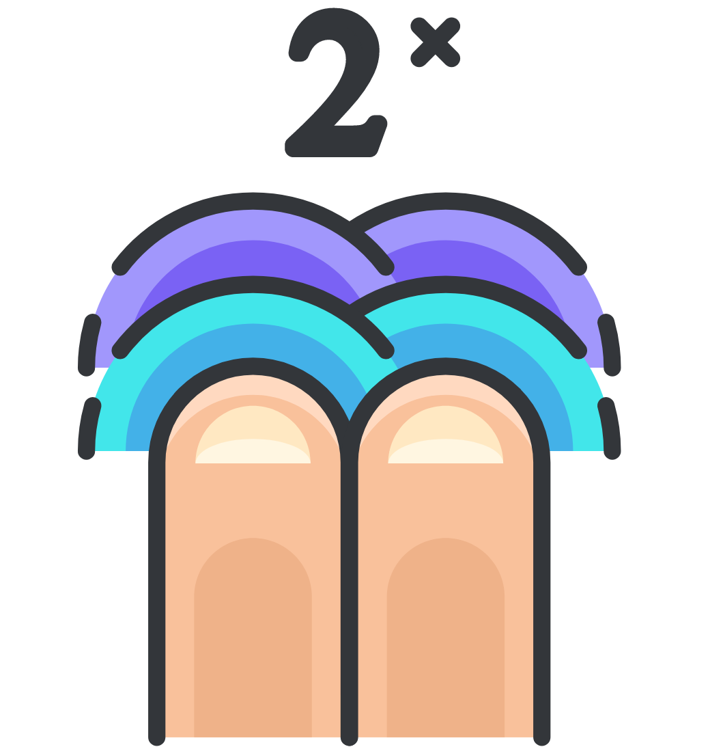
What we know about the channel
$7 Trillion
The IT spending pie is destined to get a whole lot bigger, doubling in size to
by the end of the decade.

Slide 6
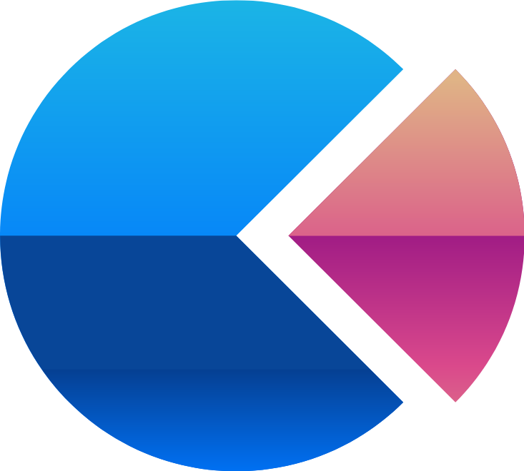
What we know about the channel
$2 Trillion
But the size of the channel’s slice will stay stagnant around
($2.2 Trillion) as marketplaces and direct grow much quicker.

Slide 7



Marketplaces experienced
of growth in the first few
months of the pandemic.
10 YEARS

Slide 8

TREND – More competition from OEMs.
According to last year’s MSP Day Report by Barracuda MSP, OEMs are invading the channel with their own offerings. Barracuda notes that a hybrid approach has grown in popularity where OEMS continue to sell their own products and software as before. However, they are augmenting this with managed services.
And 59% of respondents to the survey expect services to account for 50% or more of their revenues. It’s a good idea to keep an eye on potential competition when deciding which IT vendors to partner with.​

Slide 9
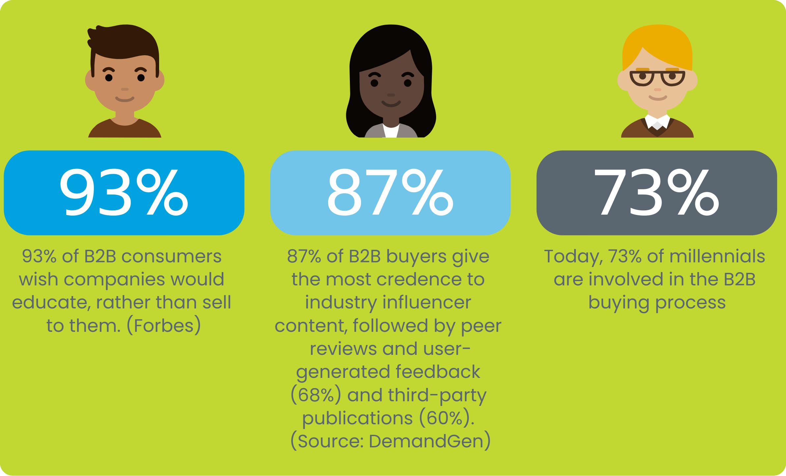
STRATEGIES
Notes:
Lengthen Your Time Horizon
Because the factors that go into a B2B purchase decision are often more nuanced and comprehensive than consumer purchases, the impact of B2B influencer marketing will naturally take longer to take root. Consumers goods companies can—in theory—pay some models to hawk bikinis on Instagram, and purchases will roll in almost immediately. It doesn’t work like that for B2B.
Further, because most B2B purchases involve multiple decision makers, it is likely to take longer for the impact of B2B influencer marketing to touch a plurality of those people. This is why, incidentally, we all should be using more influencers in cooperation with account-based marketing
In the estimation of me and our strategist here at Convince & Convert, you shouldn’t expect results from a B2B influencer marketing program for at least six months, and you should seek to work with B2B influencers one year at a time. This differs a lot from B2C influencer programs, which can be as short as 30 days.

Slide 10


Trends - Looking ahead - 2023 and beyond
Retargeting - Google is set to phase out third-party cookies by the end of next year due to rising privacy concerns.
Emphasis on consumer privacy - If generating qualified leads is your marketing goal for 2023, you may want to look into upgrading your privacy software.
California Privacy Right Act (CPRA), Colorado Privacy Act (CPA), Virginia Consumer Data Protection Act (CDPA) go into effect in 2023.
https://www.squirepattonboggs.com/-/media/files/insights/publications/2022/05/preparing-for-2023-state-privacy-law-compliance/preparingfor2023stateprivacylawcompliance.pdf

Slide 11
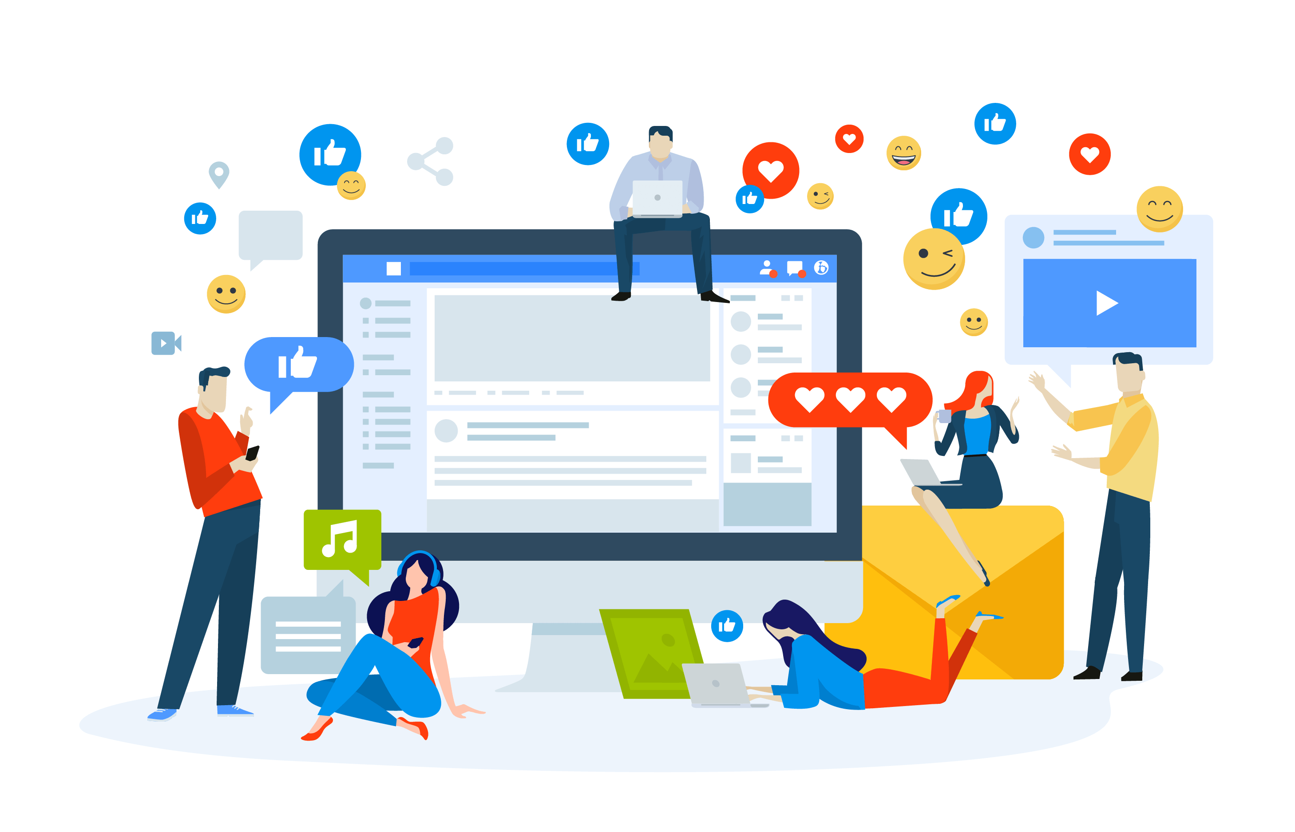
Strategies – Content Communities
LIVE STREAMING & VIDEO
INTERACTIVE CONTENT
SHAREABLE CONTENT
TYPES:
  Case Studies
  Thought Leadership
  Testimonials
  Product Launch
  Event Recap

Slide 12
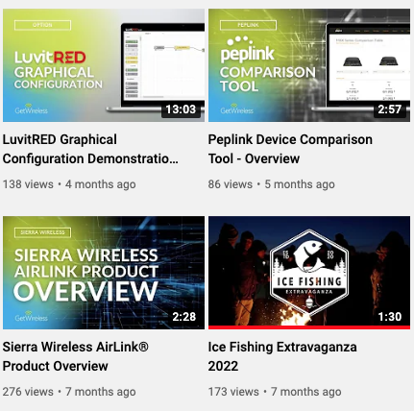
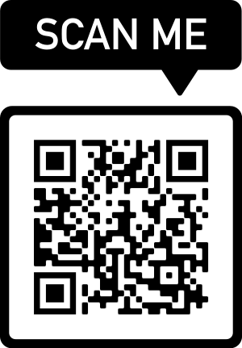
Strategies - Content Communities - Video
According to a recent study by HubSpot, video marketing is a top priority for B2B businesses. Their findings are as follows:
78%
of LinkedIn videos on their platform are viewed without sound
81%
marketers believe that video has a positive impact on sales.
81%
viewers report watching explainer videos to learn more about products
88%
Uses YouTube as main platform
96%
viewers report watching explainer videos
86%
Businesses use video

Slide 13

Strategies - ABM + IBM
This intersection of ABM and influencer marketing represents one of the most promising frontiers for B2B marketing, especially when it comes to the pursuit of enterprise customers.
Nick Nelson
B2B Marketing, Influencer Marketing

Slide 14
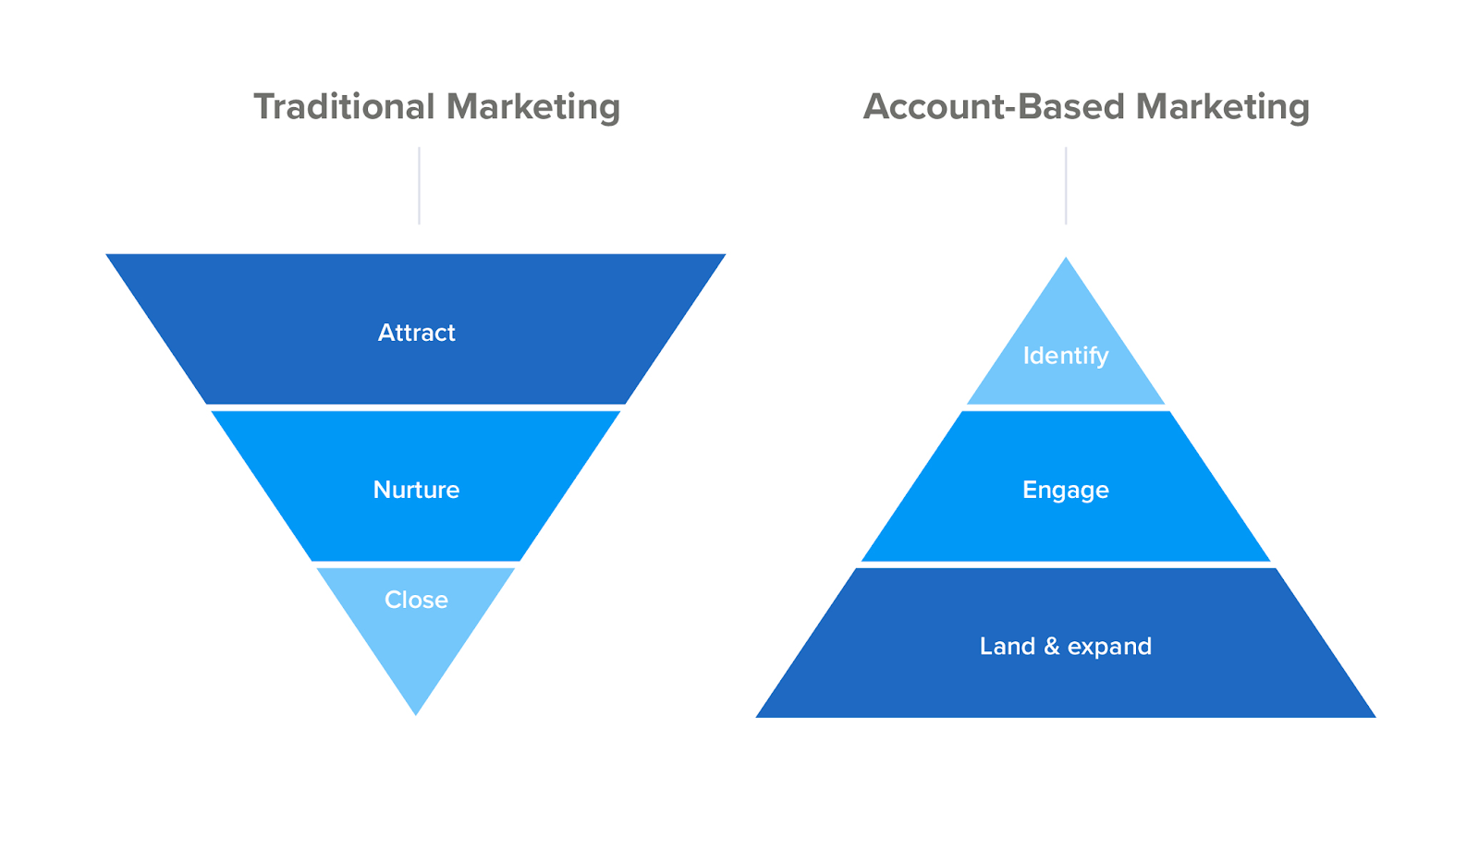
Account Based Marketing
As the saying goes, if you’re talking to everyone, you’re talking to no one.
ABM provides a focused framework for pursuing your ideal prospective customers.

Slide 15
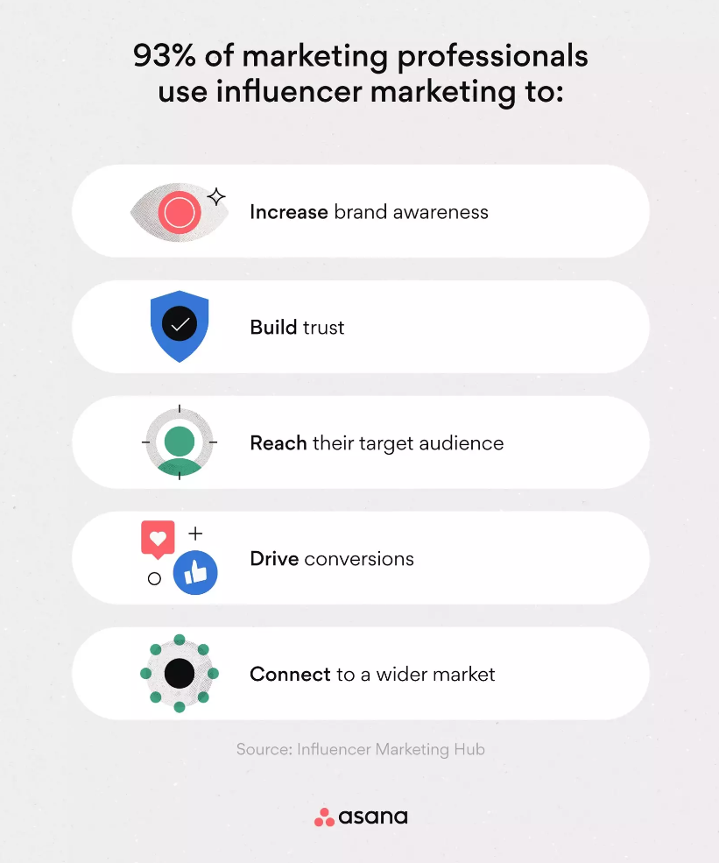
Influence Based Marketing
IBM can be the perfect pairing with the approach, providing additional voices who can speak authentically and credibly to the exact people you want to reach.

Slide 16
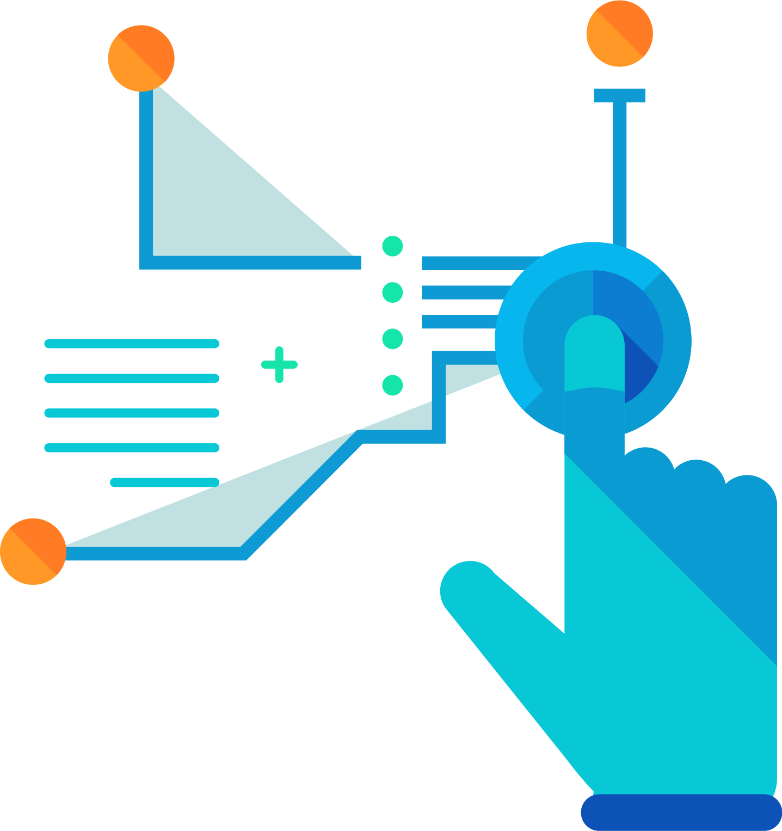
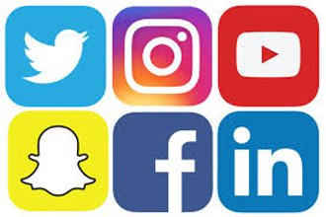






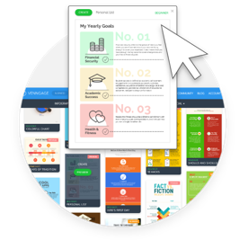



Tool Chart

Slide 17
Toolkit Links
FREE
REASONABLE INVESTMENT
Social Media Scheduling: Hootsuite and Buffer
Graphics: Canva
Video Creator: Animoto, Adobe Express
Real-time Analytics: Google Analytics
CRM: HubSpot’s Free CRM
Copy edit: Grammerly
Surveys: SurveyMonkey
Email Marketing: Mailchimp
Medica notifications: Google Alerts or free Talkwalker Alerts service
QR Code Generator
Sprout Social
Venngage
Biteable
SEMRush
Salesforce or Hubspot paid
Upgraded version of Grammerly
Upgraded Surveys: SurveyMonkey

Slide 18
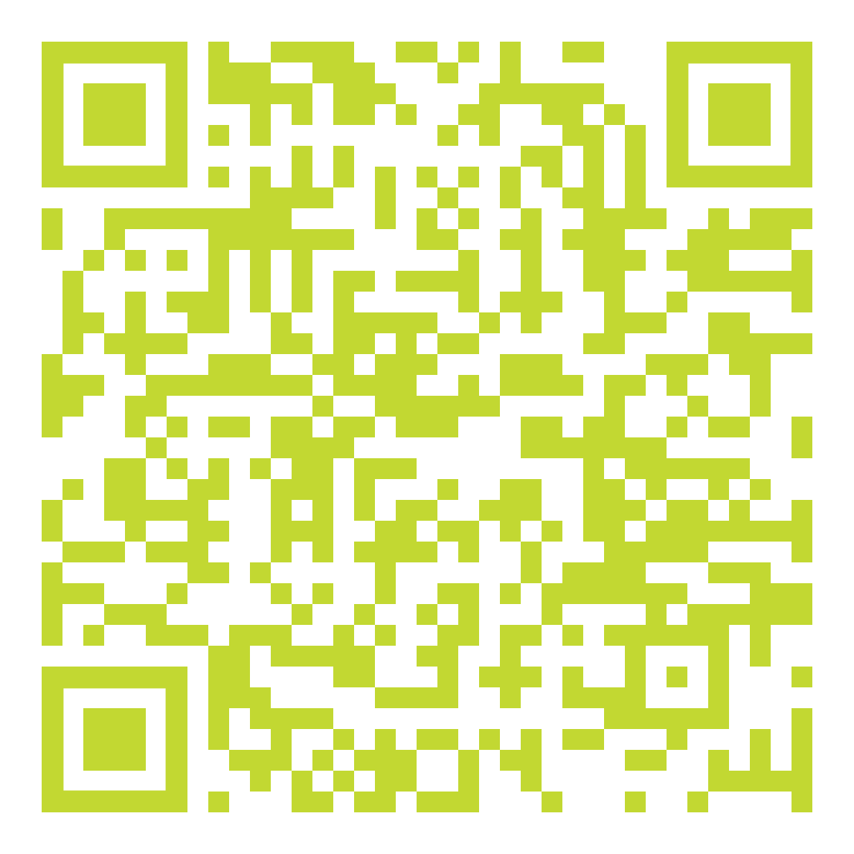
Scan to Download
Presentation
In Accenture’s report, “Make Music, Not Noise,” they found that, “companies that help their channel partners share customer data and generate leads are 63% more likely to exceed their revenue goals through channel partner networks.”

Slide 19
THANK YOU
Terra Bastolich, CMO

